Slide 1


Project SPI
</>
Web Development
By Muhib’s Group

Slide 2
Project SPI
Project SPI is our first ever project that displays a concept of institute webpage. This Project contains every necessary objects, contents and other detail about a institute website. We, our group has completed the project in shorter times for make it more challenging. We think that making a project challenging is best for our team members. We proud for our guideline and instructor(junior) “Mst. Rabia Akter” to help and train us to make the project far better. Note : This webpage may contain real details about teacher, lab, and so on. But we cannot guarantee you that they are fully similar with Sylhet Polytechnic Institute.
Thank You
- Muhib’s Group
Submitted to : Rabia Akter (Junior Instructor) Computer Technology

Slide 3
Website
A website is a collection of web pages and related content that is identified by a unique domain name and made available on the internet. Websites can be created for a variety of purposes, such as providing information, selling products or services, and facilitating communication.
Static Website : Only can view contents (Frontend Only)
Dynamic Website : Also can add/remove elements (Frontend + Backend)
As this is our first ever project, we’ve created this site as Frontend (Static Website)

Slide 4

Contents in this Project
Our Team
Main Page
Routine
Admission Form
Teacher’s List
Result Page
Students List
Notice Page
LAB Details
Md. Muhib [577952]
Md. Alfi Mia [577961]
Md. Mohiuddin [577971]
Ajijoul Hakim [577948]
Jhulon Kumar Roy [577962]
Sadikul Islam [577982]

Slide 5
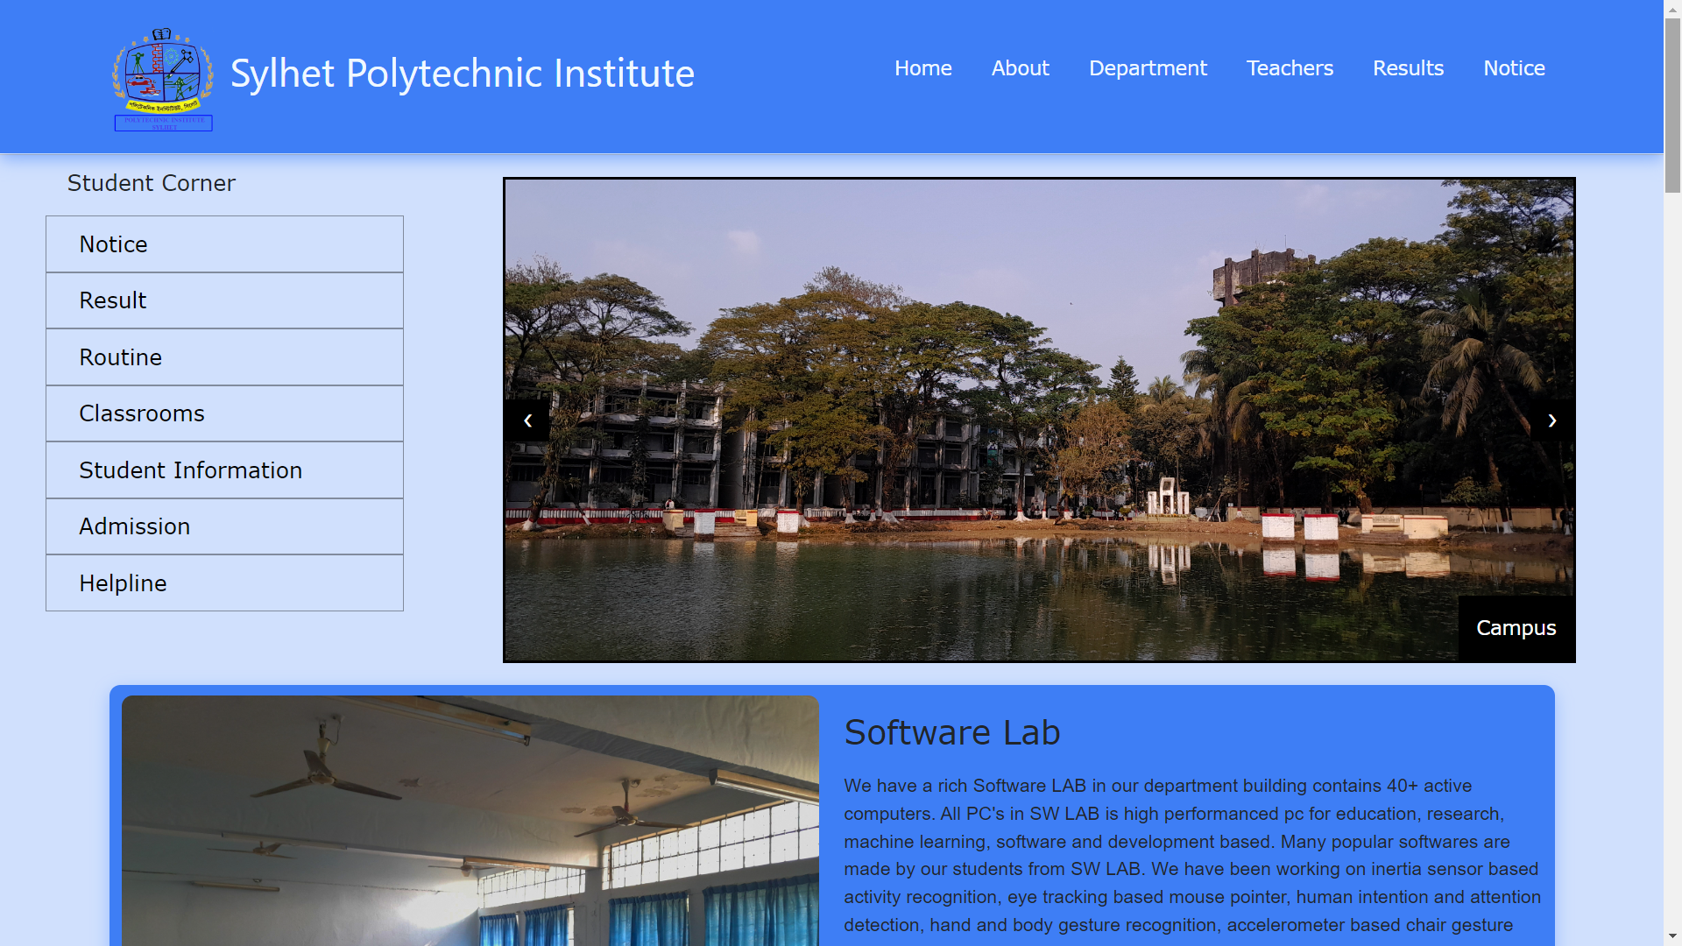
index.html (Landing Page)

Slide 6
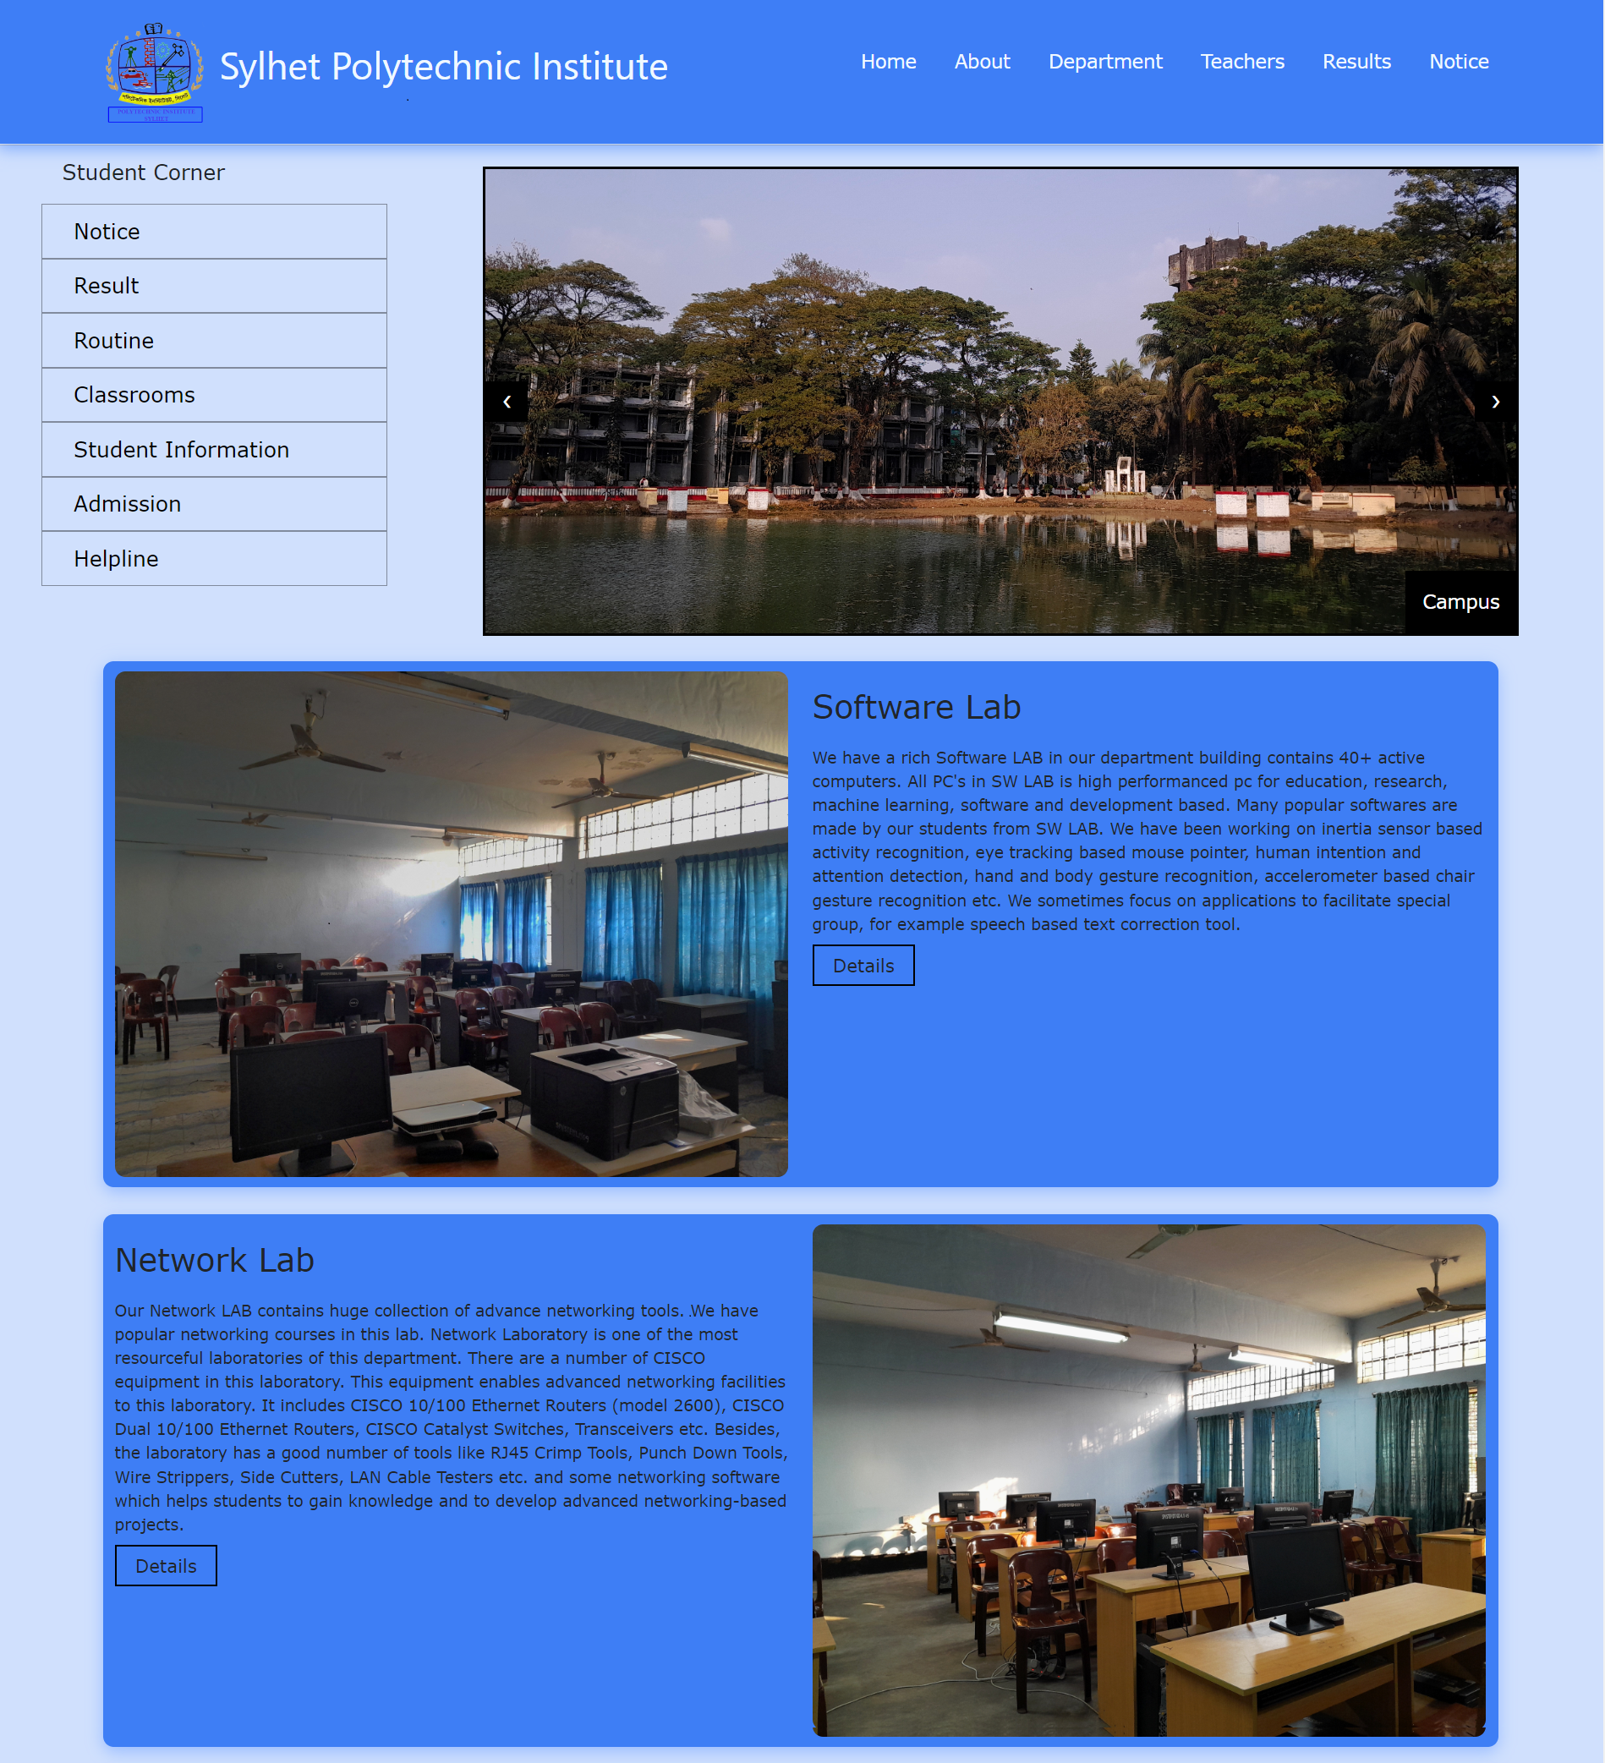
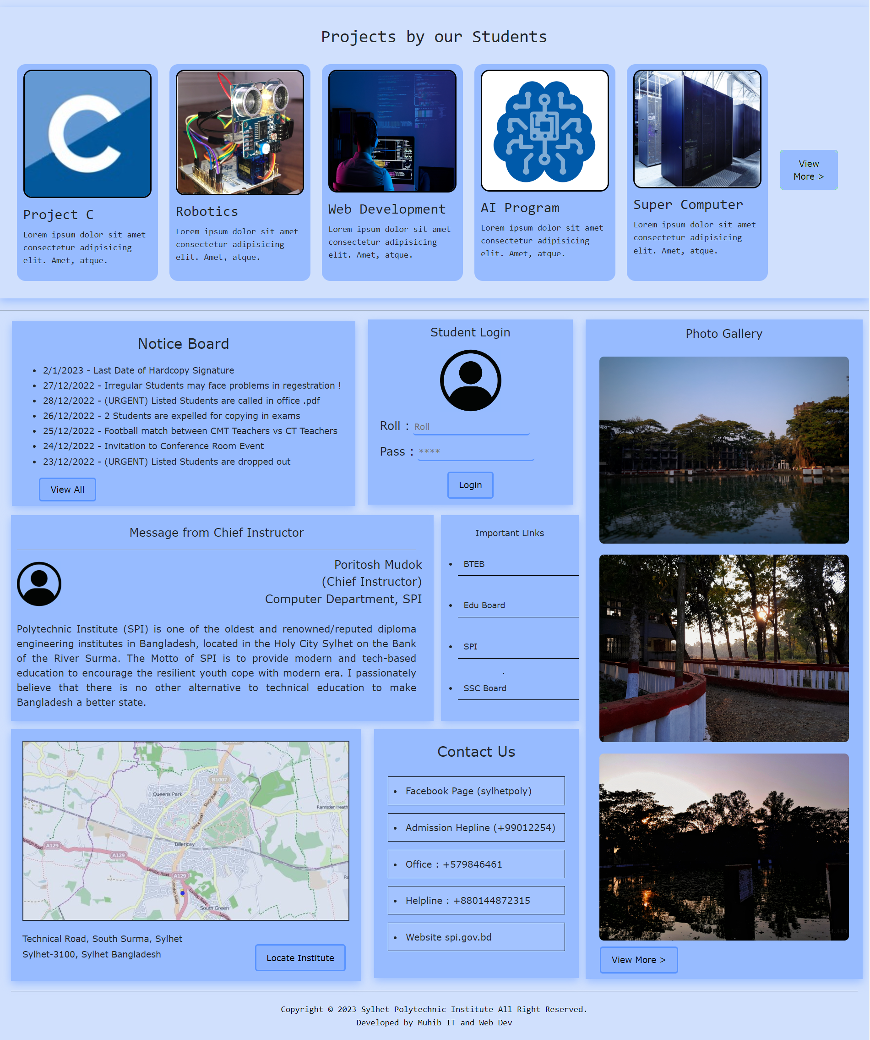
Full Layout

Slide 7
Structure of Site (First Half)
logo
navbar
Student Corner Section
Image Slide
LAB Image
LAB Details

Slide 8
Structure of Site (Last Half)
Projects
Notice
Login
Links
Speech
Image
Map
Contacts
Footer

Slide 9
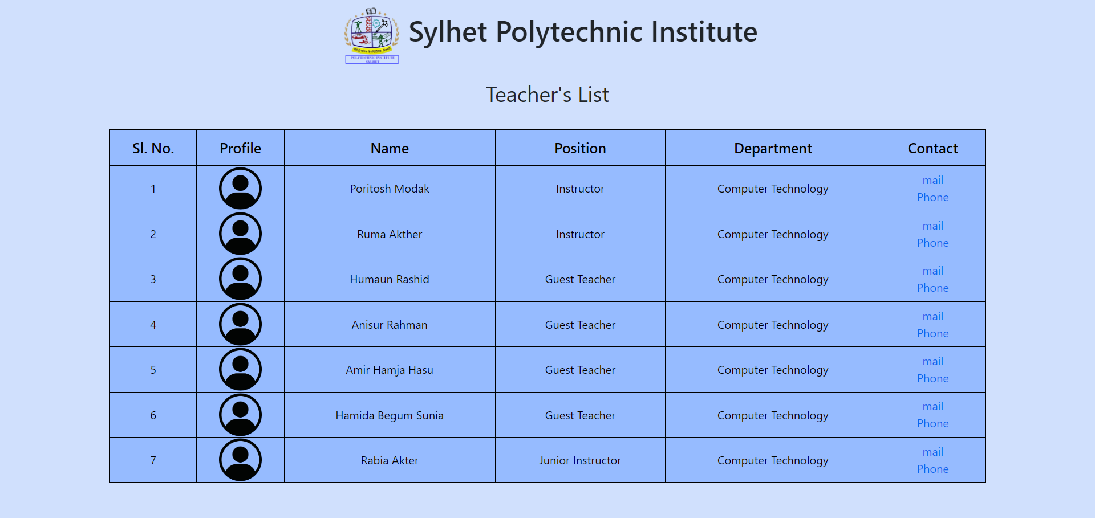
Sub Pages (Teacher’s Info)
This page table contains our honorable teacher’s details and information.
This page might be helpful for students in this institute
We can also contact teacher for our help through this page

Slide 10
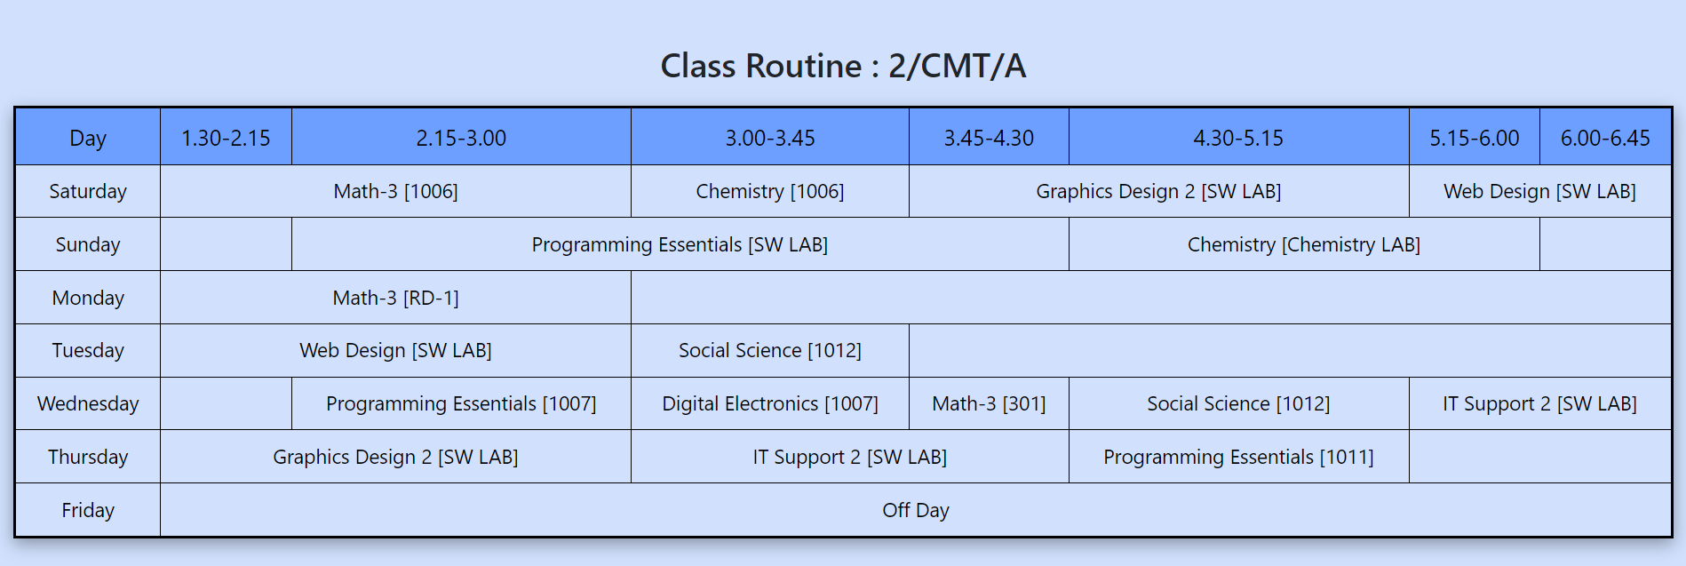
Sub Pages (Routine)
This Page contains class routines of 2,4,6 semester class with subject name and classroom number.
You can access this page from Student Corner Section > Routine

Slide 11
Use of Bootstrap
Bootstrap (ver : 4 offline) is used to responsive this site.
FileDirectory :
/root/css/bootstrap.css
The Container and Row Column Grid System was very easy to use and made the site responsive
col-lg-8
col-lg-4
R1
col-lg-5
col-lg-3
R2
col-lg-6
col-2
col-lg-6
R3
col-lg-4
col-lg-4

Slide 12
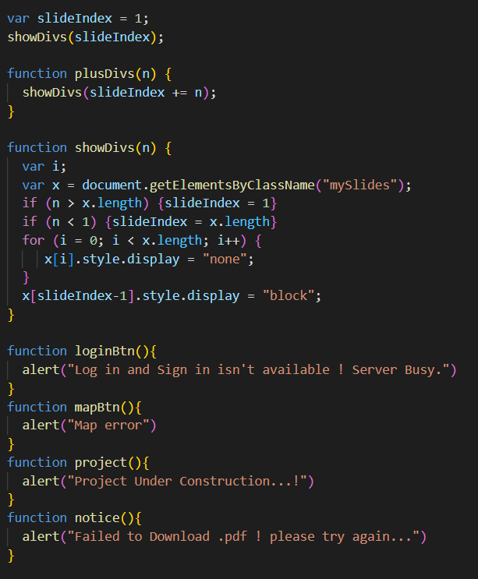
Use of JavaScript
JavaScript are used in this site to make this site more convenient
We’ve used JS for alert and slide
File Directory : /root/script.js

Slide 13
Details
Font : Roboto, sans-serif
Color : #d0e0fd
Type : Static Webpage
Date Created : 15 January 2023
Size : 100MB+ (with resource files)
Language Used : HTML, CSS, JavaScript, Bootstrap
Resolution : 1920x1080 @60Hz
Files (Google Drive) : https://drive.google.com/file/d/1fmT2RdFZNGs65b3HWHin5xH1MAhgrh-u/view?usp=share_link
Online (GitHub) : https://muhib68442.github.io/Project-SPI/

Slide 14
Future of this Project
In Future, if any institute/college/school needs a website like ours, we are always active to do a new job !
We hope that this project will make a college tasks easier and convenient.
Usefulness
A Institute can easily manage details with this site
A Student can easily manage his routine, notice through the page
Anyone can easily get information about institute.
We, Our Team are Hopeful that this project will success and can perform best in marketplace. And in Future, we will success through a single project like this one,

Slide 15
Thank You

